Slide 1


E-Commerce Sales & Customer Experience
Interactive Dashboard Performance Summary, Multidimensional Revenue Analysis, and Strategic Optimization Roadmap.
Executive Presentation
Power BI Desktop
Sales & CSAT Analytics

Slide 2






Project Objectives & Tech Stack
Business Goals
Tools & Tech Stack
Analytical Scope
Deliver actionable commercial intelligence across total revenue ($5.11M aggregate, $472.45K filtered cohort), order volumes, basket size ($1.02K AOV), fulfillment speed, and customer ratings.
Built using Power BI Desktop with custom DAX data modeling, dynamic slicers for regional/category drilling, cross-filtering, and an executive dark-themed interface.
Evaluates three core layers: macroeconomic revenue trends, category and regional performance distributions, and customer satisfaction correlations with logistics and payment modes.

Slide 3

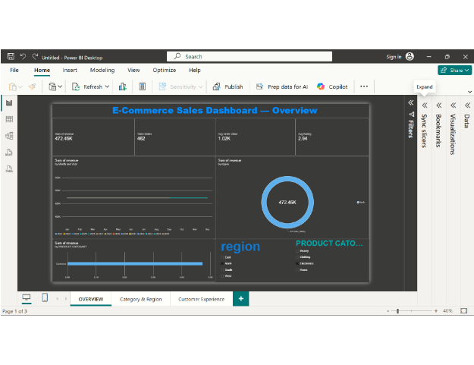

Sales Performance Overview
$472.45K Cohort Sales
462 Total Orders
$1.02K Avg Order
Consistent Revenue Generation: The filtered North/Electronics cohort records $472.45K across 462 orders, reflecting robust ticket size stability (~$1.02K AOV).
Monthly Sales Stability: Multi-year trend lines indicate sustained baseline revenue performance across recurring seasonal purchase cycles.
CSAT Rating Baseline: Average satisfaction holds at 2.94 / 5.00, pinpointing immediate opportunities for post-purchase fulfillment improvements.

Slide 4
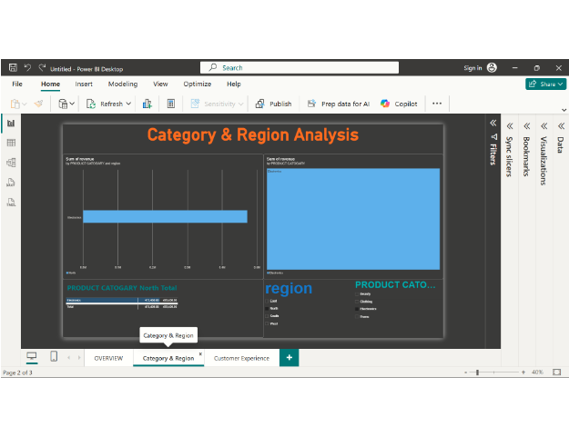
Category & Regional Analysis
Electronics Leading Category
$472,450 North Total
4 Zones East, N, S, W
Electronics Dominance: Electronics serves as the premier gross merchandise value driver, commanding dominant market share across regions.
Regional Market Footprint: Clear regional segmentation highlights the North market as a major revenue generator ($472.45K in top category alone).
Untapped Category Potential: Beauty, Clothing, and Home categories represent high-growth whitespace for targeted bundle offers and cross-merchandising.

Slide 5
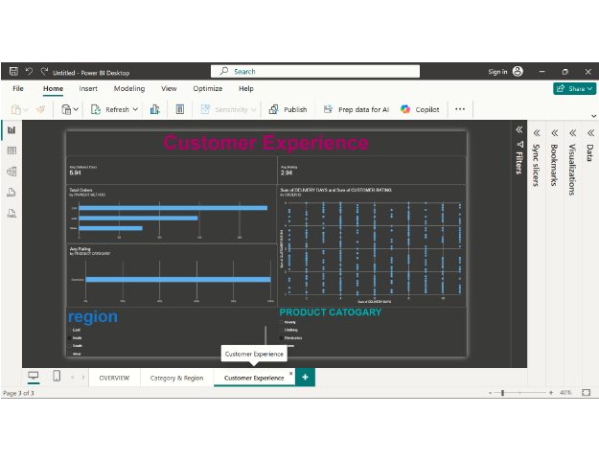
Customer Experience Insights
5.94 Days Avg Delivery
2.94 / 5 Avg CSAT
Card Pay Top Channel
No Linear Delivery Correlation: Scatter plot distribution proves customer ratings (1-5) are evenly dispersed across 1 to 10 delivery days, revealing speed is not the sole CSAT driver.
Payment Channel Preference: Credit/Debit card transactions lead total order count (~225+ orders), followed by Cash on Delivery (~148) and Digital Wallets (~89).
Experience Optimization: The sub-3.0 satisfaction index indicates that product quality, expectation matching, or packaging requires operational intervention.

Slide 6

Key Takeaways & Action Plan
Key Findings
Strategic Roadmap
Strong Financial Foundation: Solid unit economics evidenced by $1.02K Average Order Value and steady multi-year run rates.
Cross-Category Bundles: Pair top-selling Electronics with emerging categories (Home, Accessories) to drive multi-item baskets and margin diversification.
Category Dependency: High concentration in Electronics exposes overall revenue to cyclical fluctuations and component pricing shifts.
Root-Cause Quality Audits: Implement automated post-delivery surveys to pinpoint why rapid deliveries (1-3 days) still receive 1-2 star ratings.
Satisfaction Disconnect: The flat ~2.94 rating distribution across all fulfillment timeframes highlights product/service quality gaps rather than transit speed.
Digital Payment Adoption: Incentivize Wallet and Card checkouts over COD with instant cashbacks to reduce logistics return overhead.

